Slide 1
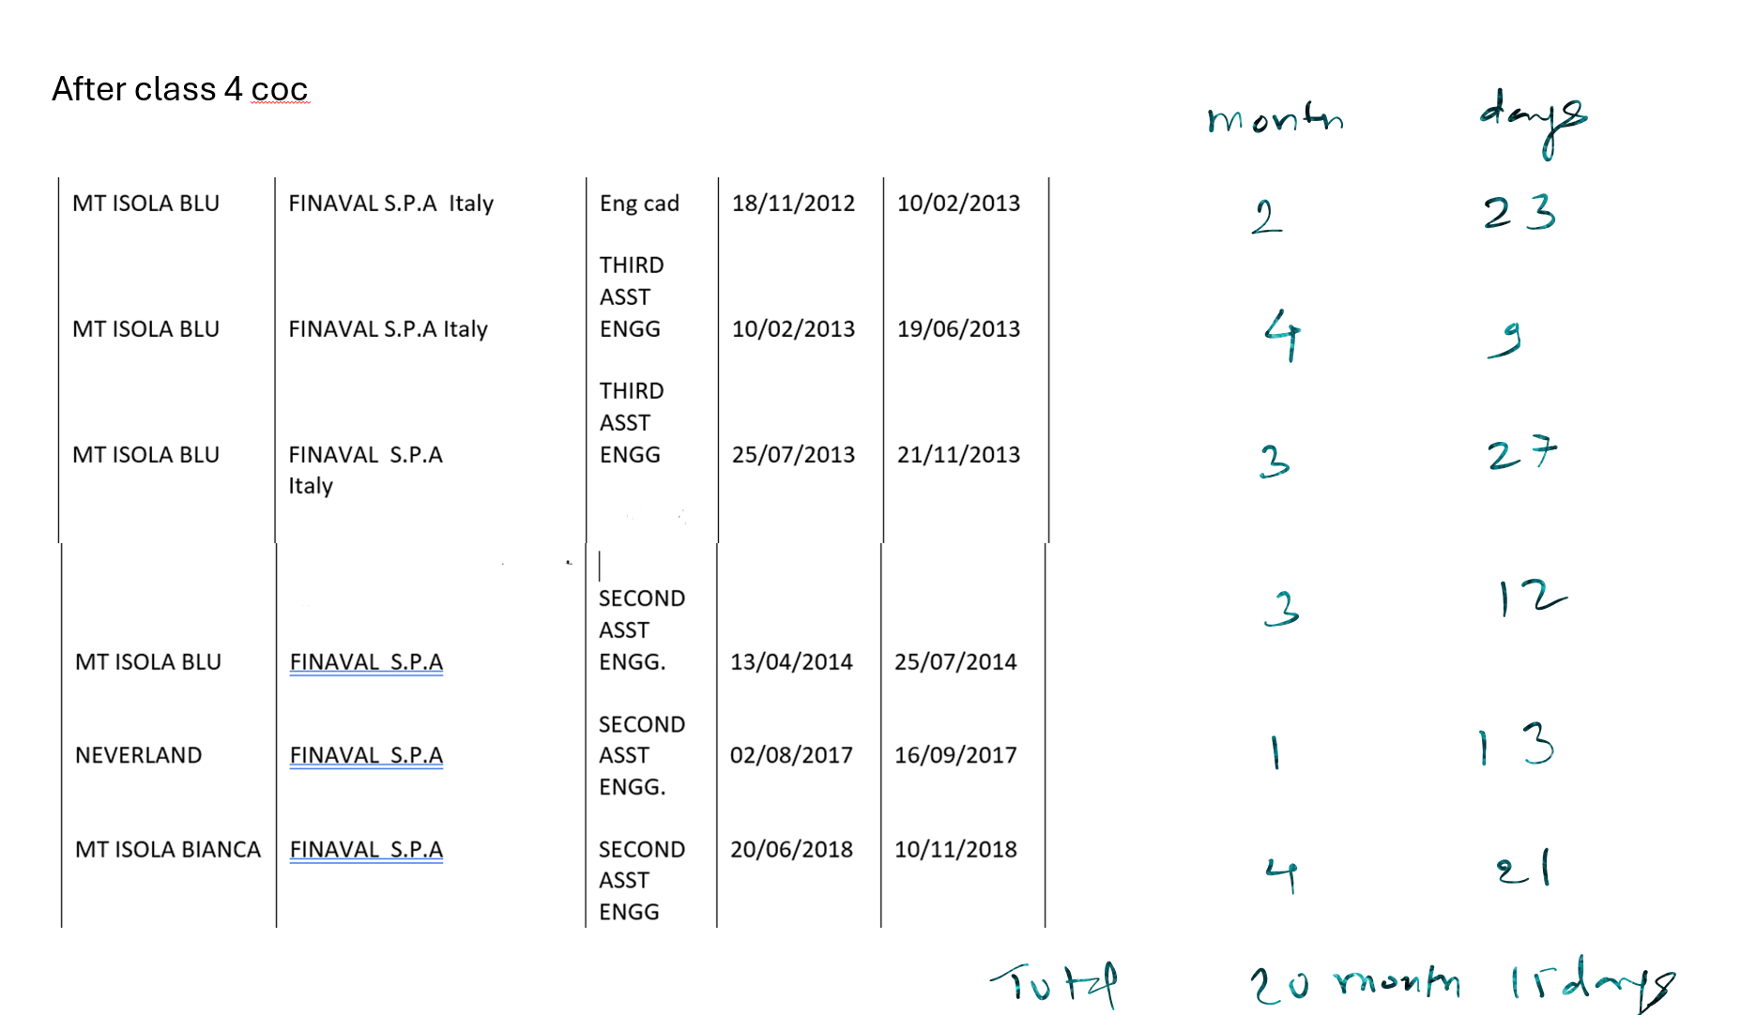

Slide 2
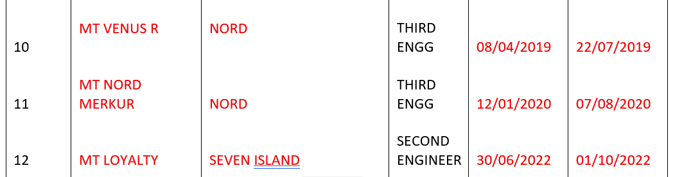


After class 2 coc
After class 4 20month 15 days
After class 2 12 month 41 days
Todal : 32 month 56 days

Slide 3
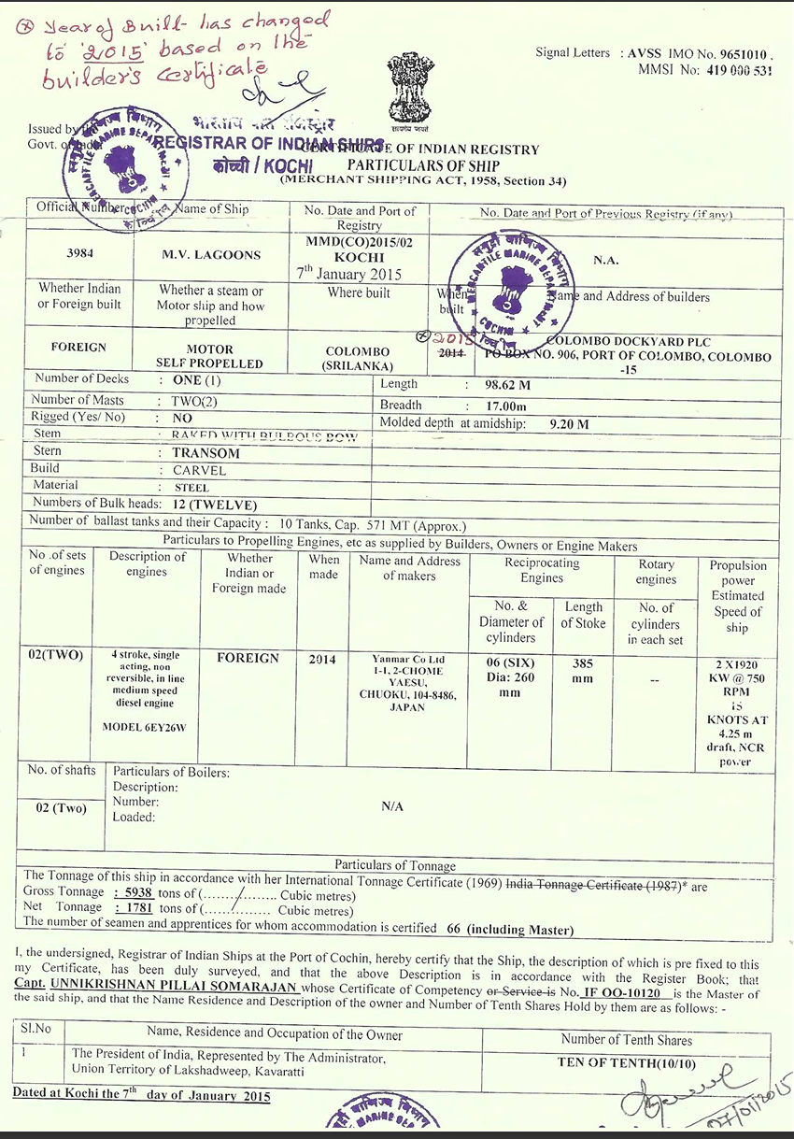
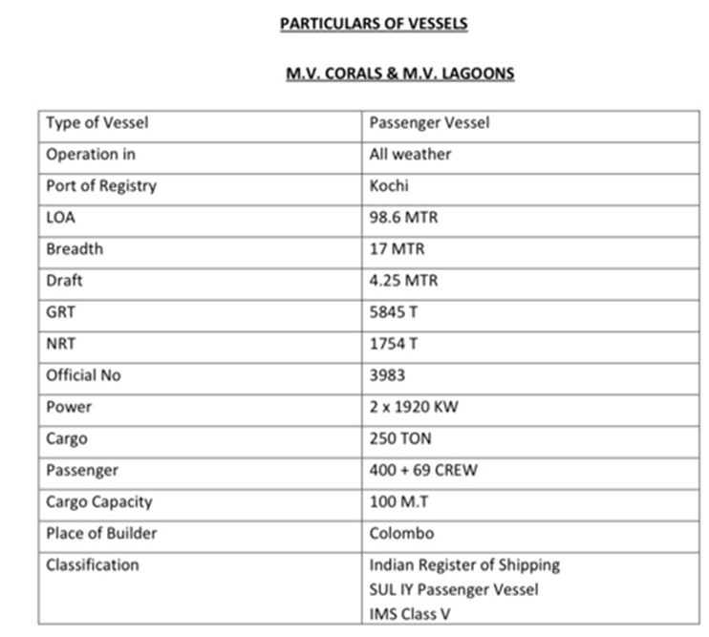
Due to personal issue could not sail after 2022,
Now , I am getting this MV LAGOON vessel to join as 2E with FG stamp, kindly confirm my sea time will be counted

